Slide 1
Classes-II
Said Nabi

Slide 2
Constructors
Member function that is automatically called when an object is created
Purpose is to construct an object
Constructor function name is class name
Has no return type
A class can have multiple constructors

Slide 3
Constructors
class Demo{
public:
Demo(){ //inline function
// Constructor
cout << "Welcome to the constructor!\n";
}
};

Slide 4
Constructors
class Demo{
public:
Demo(); // Constructor
};
Demo::Demo() //out-of-line
{
cout << "Welcome to the constructor!\n";
}

Slide 5
Constructors
Whenever an instance of a class is created, the constructor is automatically called
  Demo dem; //object dem is created
  //Prints
  Welcome to the constructor

Slide 6
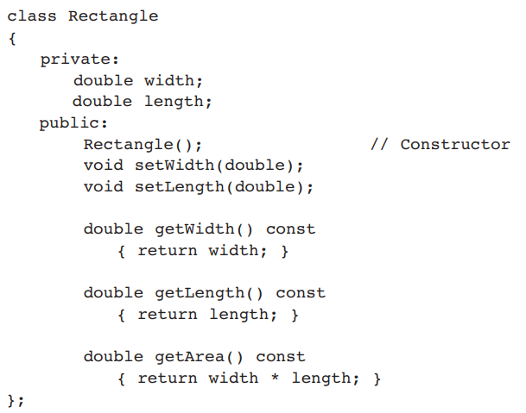
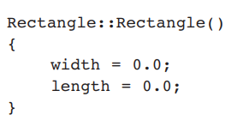
Constructors

Slide 7
What Constructors Do
Help in initializing class data members
  Employee( ) { id = 0; }
Allocate memory for dynamic members
  Employee() {
  char* nameptr = new char[20];
  }
Allocate any needed resources
  Such as to open files, etc

Slide 8
Default Constructors
A class can have only one default constructor
A default constructor is a constructor that takes no arguments
If you write a class with no constructor at all, C++ will write a default constructor for you, one that does nothing.
A simple instantiation of a class (with no arguments) calls the default constructor:
  Rectangle r;

Slide 9
Parametrized Constructors
To create a constructor that takes arguments:
  indicate parameters in prototype:
Rectangle(double, double);
  Use parameters in the definition:
Rectangle::Rectangle(double w, double len)
{
width = w;
length = len;
}

Slide 10
Parametrized Constructors
You can pass arguments to the constructor when you create an object:
  Rectangle r(10.7, 5.2);
Constructors can be overloaded
Rectangle(double w, double len, double ar){
width = w;
length = len;
area = ar;
}
Rectangle r(10.0, 5.0, 50.0);

Slide 11
More About Default Constructors
If all of a constructor's parameters have default arguments, then it is a default constructor. For example:
Rectangle(double len = 0, double wid = 0){
length = len; width = wid;
}
Creating an object and passing no arguments will cause this constructor to execute:
Rectangle r;
Cannot create multiple default constructors - ERROR

Slide 12
More About Default Constructors
Rectangle(double len = 0, double wid = 0){
length = len; width = wid;
}
Creating an object and passing no arguments will cause this constructor to execute:
Rectangle r;
Rectangle r1(10.0);
Rectangle r2(10.0, 2.0);
All three cause the same constructor to execute
With this constructor, cannot create any other constructor with 0,1 or 2 parameters.
Because then the compiler cannot differentiate and decide which one to call

Slide 13
Classes with No Default Constructor
When all of a class's constructors require arguments, then the class has NO default constructor.
When this is the case, you must pass the required arguments to the constructor when creating an object.

Slide 14
Destructors
Member function automatically called when an object is destroyed
Destructor name is ~classname, e.g., ~Rectangle
Has no return type; takes no arguments
Only one destructor per class, i.e., it cannot be overloaded
If constructor allocates dynamic memory, destructor should release it

Slide 15
Constructors, Destructors, and Dynamically Allocated Objects
When an object is dynamically allocated with the new operator, its constructor executes:
Rectangle *r = new Rectangle(10, 20);
When the object is destroyed, its destructor executes:
delete r;

Slide 16
Only One Default Constructor and One Destructor
Do not provide more than one default constructor for a class: one that takes no arguments and one that has default arguments for all parameters
  Square();
  Square(int = 0); // will not compile
Since a destructor takes no arguments, there can only be one destructor for a class

Slide 17
Member Function Overloading
Non-constructor member functions can also be overloaded:
  void setCost(double);
  void setCost(char *);
Must have unique parameter lists, like overloaded constructors

Slide 18
When Constructors and Destructors Are Called
Constructors and destructors called automatically
Global scope objects
  Constructors called before any other function (including main)
  Destructors called when main terminates (or exit function called)
Local scope objects
  Constructors called when objects are defined
  Destructors called when objects leave scope

Slide 19
class Item {
  private:
  double cost;
  int units;
  public:
    Item() { //Default Constructor
    cost = 0.0;
    units = 0; }
    Item(int costVal){ //Constr 1 parameter
    cost = costVal;
    units = 0; }
    Item(double c, int u) { //Constr 2 parameters
    cost = c;
    units = u; }
};

Slide 20
Arrays of Objects
Objects can be the elements of an array:
  Item inventory[40];
Default constructor for object is used when array is defined

Slide 21
Arrays of Objects
Must use initializer list to invoke constructor that takes arguments:
  Item inventory[3] ={ 22.4, 10.30, 99.0 };
The compiler treats each item in the initializer list as an argument for an array element’s constructor

Slide 22
Arrays of Objects
If the constructor requires more than one argument, the initializer must take the form of a function call:
Item inventory[] = {Item(6.95, 12), Item(8.75, 20), Item(3.75, 10) };

Slide 23
Arrays of Objects
It isn't necessary to call the same constructor for each object in an array:
  Item inventory[] = {
  20.5, Item( 8.75, 20),
  45.0
  };

Slide 24
Accessing Objects in an Array
Objects in an array are referenced using indexes
Member functions are referenced using dot notation:
  inventory[2].display();

Slide 25
Array of pointers to objects
Declare an array of pointer to objects
Allocate and initialize each object in a loop
  Date *dates[31];
  for (int day = 0; day < 31; ++day) {
  dates[day] = new Date(3, day, 2020);
  }

Slide 26
Default Member-wise Assignment
Assignment operator (=) can be used to assign an object to another object of the same type.
Member-wise assignment: each data member of the object on the right of the assignment operator is assigned individually to the same data member in the object on the left

Slide 27
Default Member-wise Assignment
class Rectangle{
double length;
double width;
public:
Rectangle(){ //default constructor
length = 0; width = 0; }
//parametrized constructor
Rectangle(double l, double w) {
length = l;
width = w; }
};
//box1 is an object of class Rectangle
Rectangle box1(10.0, 20.0);
box1
length = 10.0
width = 20.0

Slide 28
Default Member-wise Assignment
//box1 is an object of class Rectangle
Rectangle box1(10.0, 20.0);
Rectangle box2;
box2 = box1;
box2
box1
length = 0.0
width = 0.0
length = 10.0
width = 20.0

Slide 29
Default Member-wise Assignment
//box1 is an object of class Rectangle
Rectangle box1(10.0, 20.0);
Rectangle box2;
box2 = box1;
Rectangle box3 = box2;
box3
box2
box1
length = 10.0
width = 20.0
length = 10.0
width = 20.0
length = 10.0
width = 20.0

Slide 30
Default Copy Constructor
A copy constructor creates an object and initializes it with another object’s data. Objects must be of the same type
If a class doesn’t have a copy constructor, C++ creates a default copy constructor for it.
Rectangle box3 = box2; OR Rectangle box3(box2);
The default copy constructor performs the member-wise assignment when an object is initialized using another object.

Slide 31
Copy constructor
A type of constructor that is used to initialize an object with another object of the same type is known as copy constructor.
It is by default available in all classes
It has the same form as other constructors, except it has a reference parameter of the same class type
syntax is ClassName(ClassName &Variable)
Rectangle(Rectangle &r)

Slide 32
Copy Constructor for Class Date
Private members can be accessed with a . here because the copy constructor is a member of the Date class
Date::Date(Date &date)
{
month = date.month;
day = date.day;
year = date.year;
}

Slide 33
Uses of the Copy Constructor
Implicitly called in 3 situations:
  Defining a new object from an existing object
  passing an object by value
  returning an object by value

Slide 34
Copy Constructor: Defining a New Object
//parametrized constructor called
Date d1(2,28,2020);
// initialize 2 local objects from d1
Date d2(d1);
Date d3 = d1;
// init a dynamic object from d1
Date* pdate = new Date(d1);

Slide 35
Copy Constructor: Passing Objects by Value
//copy constructor called for each value arg
int dateDiff(Date d1, Date d2);
...
Date today; //default constructor called
Date d3(02, 21, 2000); //parametrized constr.
cout << dateDiff(d3, today);

Slide 36
Some Issues with the Default Copy Constructor
There are instances, where the default copy constructor can be problematic

Slide 37
class Student{
private:
char *name;
public:
Student(){ //default constructor
name = new char[12]{0};
}
void setName(char* nameVal){ //setter for name
strcpy(name,nameVal);
}
}
char* getName(){ //getter for name
return name; } };
s1
name
Dynamically
allocated array
B | r | u | c | e |  | W | a | y | n | e
int main(){
Student s1;
char name1[]="Bruce Wayne";
return 0; }

Slide 38
int main(){
Student s1;
char name1[]="Bruce Wayne";
s1.setName(name1);
cout<<s1.getName()<<endl;
Student s2 = s1;
return 0; }
s1
name
Dynamically
allocated array
B | r | u | c | e |  | W | a | y | n | e
s2’s default copy constructor is called
and s1’s member variable values are copied in s2
name
s2
Output
Bruce Wayne

Slide 39
int main(){
Student s1;
char name1[]="Bruce Wayne";
s1.setName(name1);
cout<<s1.getName()<<endl;
Student s2 = s1;
cout<<s2.getName()<<endl;
return 0; }
s1
name
Dynamically
allocated array
B | r | u | c | e |  | W | a | y | n | e
Pointers in both objects will point to the same address a.k.a shallow copy
name
s2
Output
Bruce Wayne
Bruce Wayne

Slide 40
s1
int main(){
Student s1;
char name1[]="Bruce Wayne";
s1.setName(name1);
cout<<s1.getName()<<endl;
Student s2 = s1;
cout<<s2.getName()<<endl;
char name2[]="Clark Kennt";
s2.setName(name2);
return 0; }
name
Dynamically
allocated array
B | r | u | c | e |  | W | a | y | n | e
name
s2
Output
Bruce Wayne
Bruce Wayne

Slide 41
int main(){
Student s1;
char name1[]="Bruce Wayne";
s1.setName(name1);
cout<<s1.getName()<<endl;
Student s2 = s1;
cout<<s2.getName()<<endl;
char name2[]="Clark Kennt";
s2.setName(name2);
cout<<s2.getName()<<endl;
cout<<s1.getName()<<endl;
return 0; }
s1
name
Dynamically
allocated array
C | l | a | r | k |  | K | e | n | n | t
name
s2
Output
Bruce Wayne
Bruce Wayne
Clark Kennt
Clark Kennt

Slide 42
Some Issues with Default Copy Constructor – Shallow Copy
Either object can manipulate the values stored in the array, causing the changes to show up in the other object.
One object can be destroyed, causing its destructor to be called, which frees the allocated memory
The remaining object’s name pointer would still reference this section of memory, although it should no longer be used

Slide 43
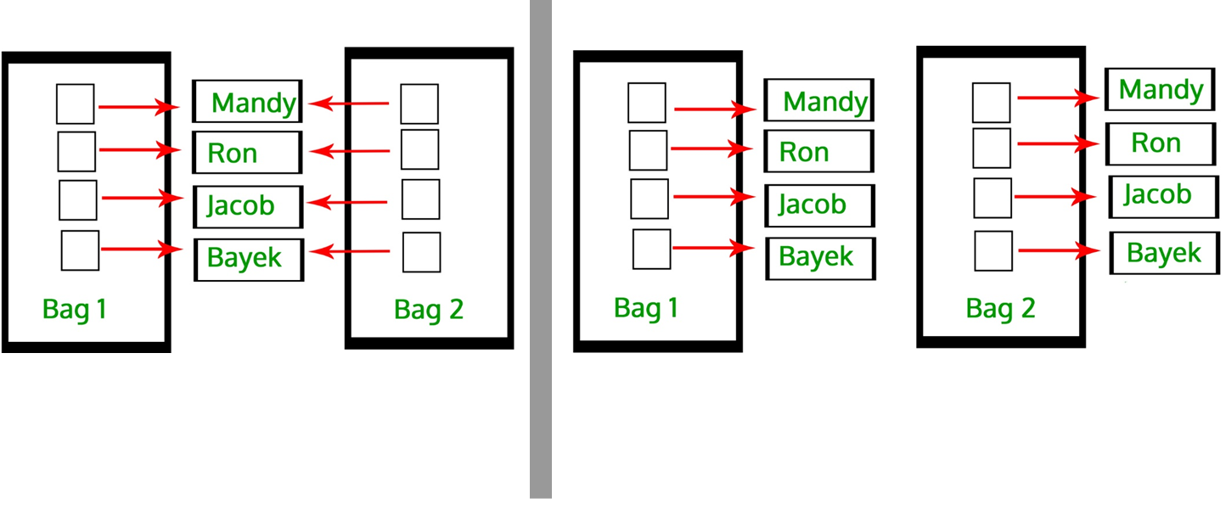
User-defined Copy Constructor, required?
Default-copy Constructor do only “Shallow Copy”
We need user-defined copy-constructor,
  When we need “Deep Copy” (for Dynamic Memory)

Slide 44
User defined Copy Constructor – Deep Copy
class Student{
private:
char *name;
public:
Student(){ //default constructor
name = new char[12]{0};
}
Student(const Student &s){ //copy constructor
name = new char[12]; //for deep copy
strcpy(name, s.name); }
}
};

Slide 45
s1
int main(){
Student s1;
char name1[]="Bruce Wayne";
s1.setName(name1);
cout<<s1.getName()<<endl;
Student s2 = s1;
cout<<s2.getName()<<endl;
char name2[]="Clark Kennt";
s2.setName(name2);
return 0; }
name
Dynamically
allocated array
B | r | u | c | e |  | W | a | y | n | e
B | r | u | c | e |  | W | a | y | n | e
name
s2
Output
Bruce Wayne
Bruce Wayne

Slide 46
s1
int main(){
Student s1;
char name1[]="Bruce Wayne";
s1.setName(name1);
cout<<s1.getName()<<endl;
Student s2 = s1;
cout<<s2.getName()<<endl;
char name2[]="Clark Kennt";
s2.setName(name2);
cout<<s2.getName()<<endl;
cout<<s1.getName()<<endl;
return 0; }
name
Dynamically
allocated array
B | r | u | c | e |  | W | a | y | n | e
C | l | a | r | k |  | K | e | n | n | t
name
Output
Bruce Wayne
Bruce Wayne
Clark Kennt
Bruce Wayne
s2

Slide 47
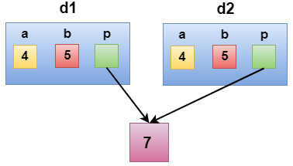
Shallow Copy
class Demo
{
int a;
int b;
int *p;
public:
Demo()
{
p=new int;
}
void setdata(int x,int y,int z)
{
a=x;
b=y;
*p=z;
}
void showdata()
{
std::cout << "value of a is : " <<a<< std::endl;
std::cout << "value of b is : " <<b<< std::endl;
std::cout << "value of *p is : " <<*p<< std::endl;
}
};
int main()
{
Demo d1;
d1.setdata(4,5,7);
Demo d2 = d1;
d2.showdata();
return 0;
}

Slide 48
Deep Copy
class Demo
{
public:
int a;
int b;
int *p;
Demo()
{
p=new int;
}
Demo(Demo &d)
{
a = d.a;
b = d.b;
p = new int;
*p = *(d.p);
}
void setdata(int x,int y,int z)
{
a=x;
b=y;
*p=z;
}

Slide 49
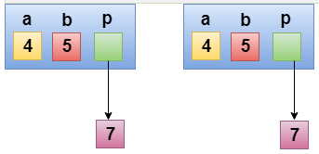
Deep Copy
void showdata()
{
std::cout << "value of a is : " <<a<< std::endl;
std::cout << "value of b is : " <<b<< std::endl;
std::cout << "value of *p is : " <<*p<< std::endl;
}
};
int main()
{
Demo d1;
d1.setdata(4,5,7);
Demo d2 = d1;
d2.showdata();
return 0;
}

Slide 50
Copy Constructor for Class Date
Copy constructors have to use reference parameters so they have access to their argument’s data.
To prevent the copy constructor from modifying the arguments data, make the copy constructors’ parameters constant
Date::Date(const Date &date)
{ month = date.month;
day = date.day;
year = date.year;
}

Slide 51

Class Instance Variables (Attributes)
class Car {
int fuel;
string model;
Car() { //constructor
fuel = 0;
model = “”;}
};
Car car1, car2, car3;

Slide 52
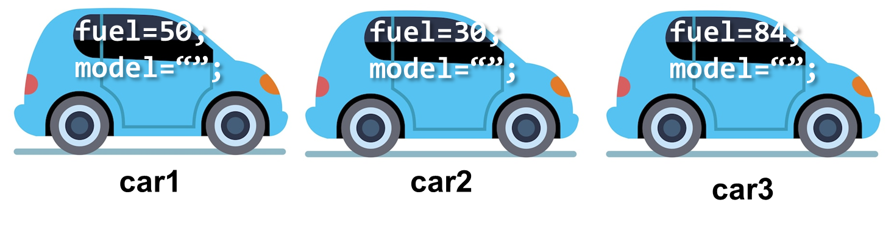
Class Instance Variables (Attributes)
class Car {
int fuel;
string model;
Car() { //constructor
fuel = 0;
model = “”;}
};
Car car1, car2, car3;
//assume class has a setter
car1.setFuel(50);
car2.setFuel(30);
car3.setFuel(84);
Each class object has its own copy of the class’s member variables.

Slide 53
static Class Members
Class members include instance variables and functions
It is possible to create a member variable or member function that does not belong to any instance of a class.
Such members are known as a static member variables and static member functions.
You can think of static class members as belonging to the class instead of to an instance of the class

Slide 54
static Member Variables
When a member variable is static, there will be only one copy of it in memory, regardless of the number of instances of the class that might exist.
A single copy of a class’s static member variable is shared by all objects of the class
Static member variables exist even if no instances (objects) of the class exist

Slide 55
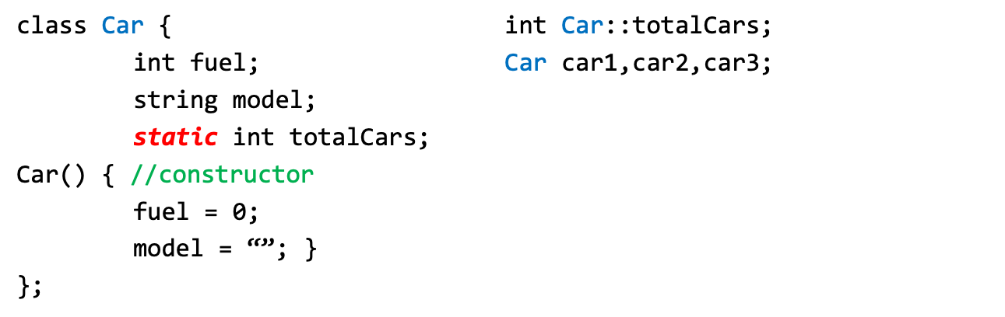
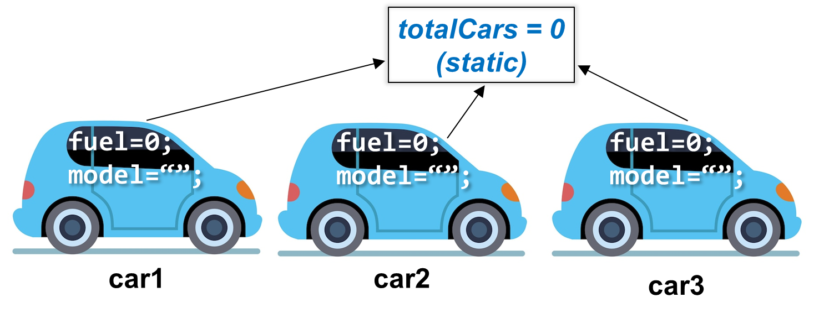

Slide 56
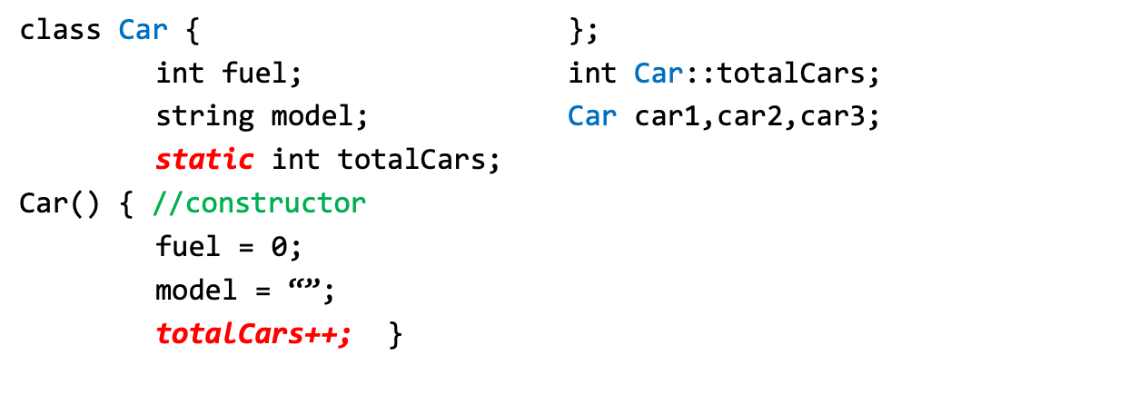


Slide 57
static Member Variables
Shared by all objects of a class
Efficient, when a single copy of data is enough
  Only the static variable has to be updated
May seems like global variables, but have class scope
  only accessible to objects of same class
Exist even if no instances (objects) of the class exist
Can be public or private

Slide 58
static Member Variables
Two-Step Procedure:
  Declare (Inside Class): static int radius;
  Define (Outside Class): int Circle::radius;
Static Variables
  Default Initialization: 0 or Null (for pointers)
  Initialization: user defined value
  Initialization is made just once, at compile time.
  Accessibility: Private or Public
This external definition statement causes the variable to be created in memory and is required.

Slide 59
Public static Member Variables
  Can be accessed using class name:
  cout << Car::totalCars;
  Can be accessed via any class’ object:
  cout << car1.totalCars;
  Can be accessed via Non-Static member functions:
  Must create object first
  cout << car1.getCars();
  Can be accessed via Static member functions:
  cout << Car::getTotalCars();
  cout << car1.getTotalCars(); //public static

Slide 60
Private static Member Variables
  Cannot be accessed using class name:
  // ERROR → cout << Car::totalCars;
  Cannot be accessed via class' object:
    // ERROR → cout << car1.totalCars;
  Can be accessed via Non-Static member functions:
  Must create object first
  cout << car1.getCars();
  Can be accessed via Static member functions:
  cout << Car::getTotalCars();
  cout << car1.getTotalCars(); //public static

Slide 61
static Member Variables
The lifetime of a class’s static member variable is the lifetime of the program
This means that a class’s static member variables come into existence before any instances of the class are created

Slide 62
static Member Functions
Static member functions can operate only on static member variables.
You can think of static member functions as belonging to the class instead of to an instance of the class.
Static member functions can be called without creating any class objects

Slide 63
static Member Functions
class Car {
int fuel;
string model;
static int totalCars;
Car() { //constructor
fuel = 0;
model = “”;
totalCars++; }
static int getTotalCars(){
return totalCars; //only access static members }
};
int Car::totalCars;

Slide 64
static Member Functions
Non-static function:
  Can access: all class members
Static functions:
  Can access: static data and static functions
  Cannot access: non-static data, non-static functions, and this pointer

Slide 65
Public static Member Functions
  Can be invoked using any class object:
      cout << car1.getTotalCars();
  Can be invoked using class name:
    cout << Car:: getTotalCars();

Slide 66
Private static Member Functions
  Cannot be invoked using class objects
    //ERROR → cout << e1.getCount();
  Cannot be invoked using class name
    //ERROR → cout << Employee::getCount();
  Can be invoked within class:
    Static member functions
    Non-static member functions

Slide 67
this Pointer
The this pointer is a special built-in pointer that is available to a class’s non-static member functions.
It always points to the instance of the class making the function call.
The this pointer is passed as a hidden argument to all non-static member functions.
void setFuel(int fuel, Car* const this) {
this->fuel = fuel;

Slide 68
this Pointer
void setFuel(int fuel, Car* const this) {
this->fuel = fuel;
}
Car car1, car2;
car1.setFuel(20); // this pointer points at car1
car2.setFuel(40); // this pointer points at car2
this pointer is a constant pointer that references to the calling object.

Slide 69
Using the this Pointer
  Not part of the object itself
Can be used to access instance variables within member functions (including constructors and destructors)
this pointer stores the address of the calling object
For a member function print data member x, either
        this->x;
        or
        (*this).x
Object Oriented Programming-Spring 23

Slide 70
Using the this Pointer
  Useful when function parameters and class member variables have the same name
  //Parametrized Constructor
Car(int fuel, string model) {
this->fuel = fuel;
this->model = model;
}
Object Oriented Programming-Spring 23

Slide 71
Using the this Pointer
Function returns a reference pointer to the same object
        { return *this; }
  Other functions can operate on that pointer
  Useful for cascading functions - multiple functions called on the same object

Slide 72
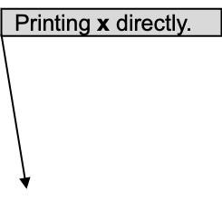
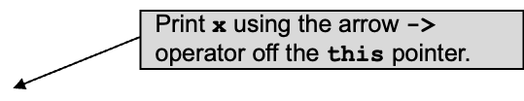
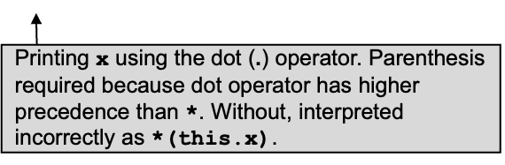
Object Oriented Programming-Spring 23

Slide 73
using variable = 12
using this pointer = 12
using this with * = 12
All three methods have the same result.
Object Oriented Programming-Spring 23

Slide 74
Notice the Time & - function returns a reference to a Time object.
Specify object in function definition.
Object Oriented Programming-Spring 23

Slide 75
Returning *this enables cascading function calls
Object Oriented Programming-Spring 23

Slide 76
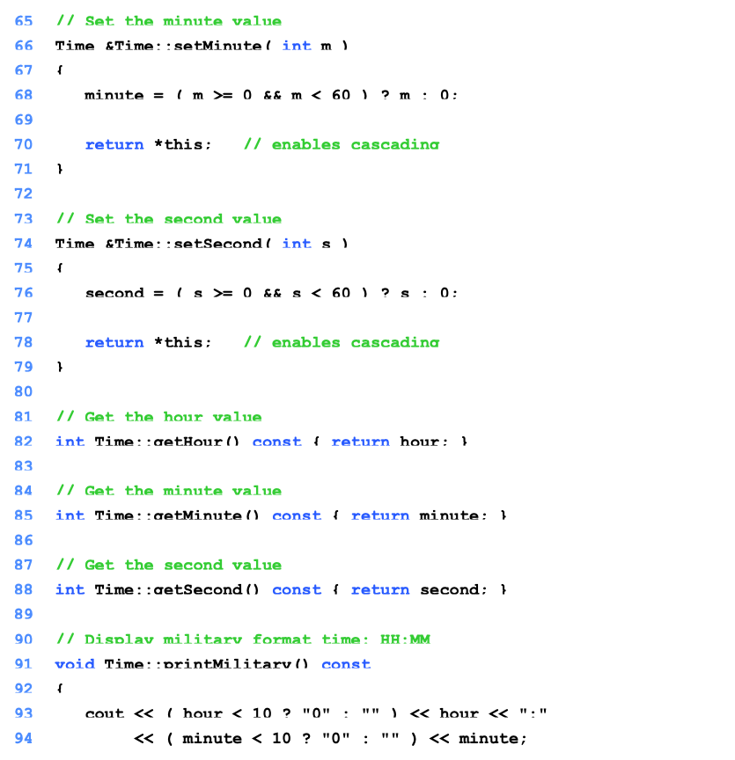
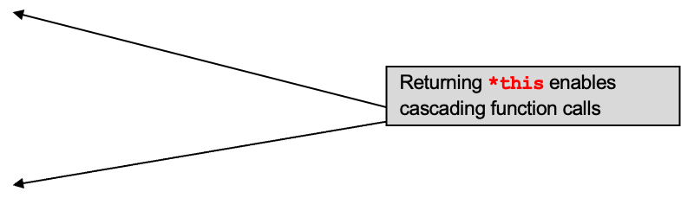
Object Oriented Programming-Spring 23

Slide 77
Using the this Pointer
Example of cascaded member function calls:
  Member functions setHour, setMinute, and setSecond all return *this (reference to an object)
  For object t, consider:
      t.setHour(1).setMinute(2).setSecond(3);
  Executes t.setHour(1), returns *this (reference to object) and the expression becomes
      t.setMinute(2).setSecond(3);
  Executes t.setMinute(2), returns reference and becomes
      t.setSecond(3);
  Executes t.setSecond(3), returns reference and becomes
      t; (Has no effect)

Slide 78

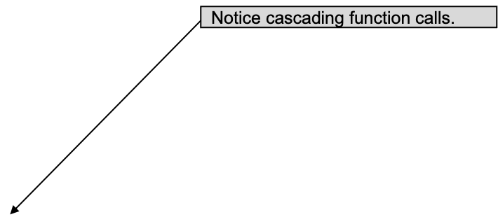
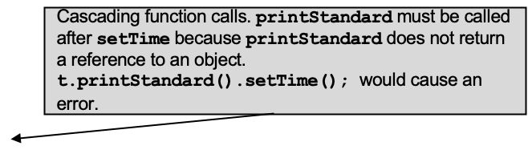

Slide 79
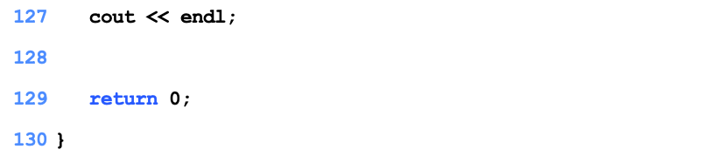
Military time: 18:30:22 PM
Standard time: 6:30:22 PM
New standard time: 8:20:20 PM

Slide 80
Member Initializer List
You have used initializer lists with arrays
  int arr[] = {1,2,3,4,5};
The data members of a class can also be initialized using an initializer list with the constructor

Slide 81
Member Initializer List
class Test {
int marks;
int total;
public:
//inline with initializer list
Test() : marks(0),total(0) {} //default constructor
Test(int m, int t) : marks(m), total(t) {}
int getMarks() {
return marks;
}
int getTotal() {
return total;
}
};

Slide 82
Member Initializer List
class Test {
int marks;
int total;
public:
Test(); //prototype
Test(int, int ); //prototype
int getMarks() {
return marks;
}
int getTotal() {
return total;
}
};
//out of line with initializer list
Test::Test() :marks(0), total(0) {}
Test::Test(int m,int t): marks(m), total(t) {}

Slide 83
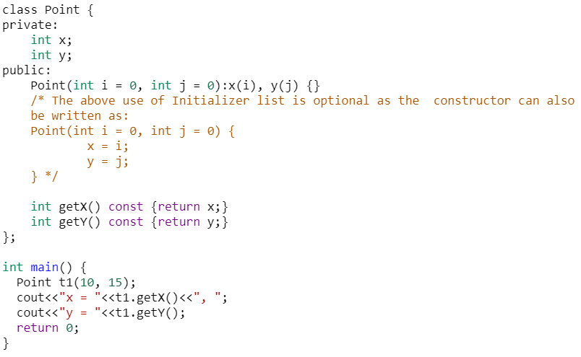
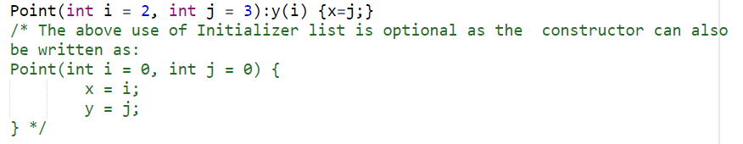
Member Initializer List (Non-const Members)
Object Oriented Programming-Spring 23

Slide 84
When to use Member Initializer List
You can use initializer list to initialize member variables but it is not necessary
But you must use an initializer list for
  Initializing a constant data member
  Initializing a reference member
Object Oriented Programming-Spring 23

Slide 85
const Class Members
As with member functions, data members can also be const
Constant members must be initialized using member initializer list

Slide 86
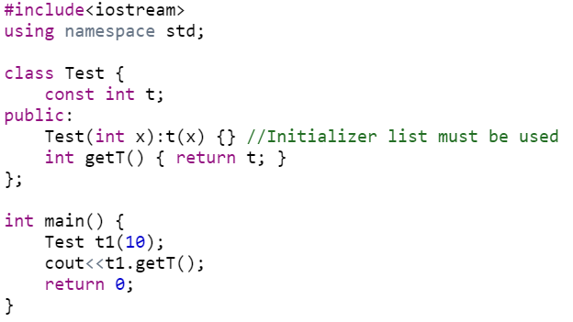
Member Initializer List (non-static const)

Slide 87
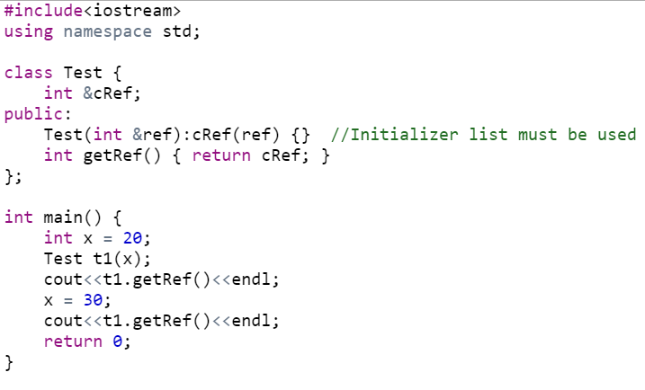
Member Initializer List (References)

Slide 88
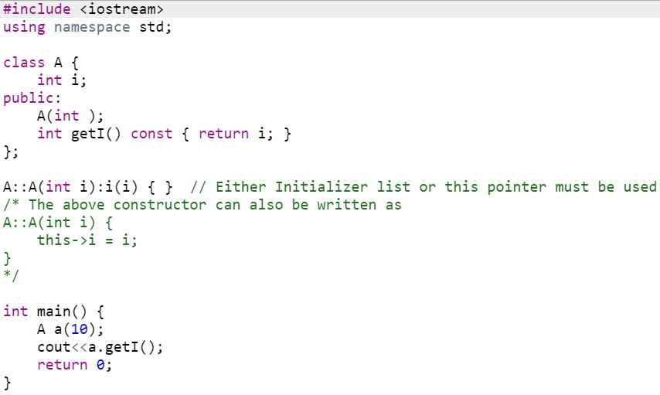
Member Initializer List
(parameter name same as data member)

Slide 89
const Objects
Read-only objects
  Object data members can only be read, NO write/update of data member allowed
  Requires all member functions be const (except constructors and destructors)
  const object must be initialized (using constructors) at the time of object creation
Notes:
The const property of an object goes into effect after the constructor finishes executing and ends before the class's destructor executes. So the constructor and destructor can modify the object, but other methods of the class can't.
The reason for this is that the compiler cannot decide whether a method performs write operations or only read operations with data members unless additional information is supplied.

Slide 90
const Objects
const property of an object goes into effect after the constructor finishes executing and ends before the class's destructor executes
  So the constructor and destructor can modify the object

Slide 91
friend Functions
A friend function is a function that is not a member of a class, but has access to the private members of the class
In other words, a friend function is treated as if it were a member of the class
A friend function can be a regular stand-alone function, or it can be a member of another class.
An entire class can also be declared a friend of another class

Slide 92
friend Functions
To declare a friend function
    Type friend before the function prototype in the class that is giving friendship
        friend int myFunction( int );
    should appear in the class giving friendship

Slide 93
friend Functions
friend functions
  Can access private members of another class
Properties of friendship
  Friendship is granted, not taken
  Not symmetric (if B a friend of A, A not necessarily a friend of B)
  Not transitive (if A a friend of B, B a friend of C, A not necessarily a friend of C)

Slide 94
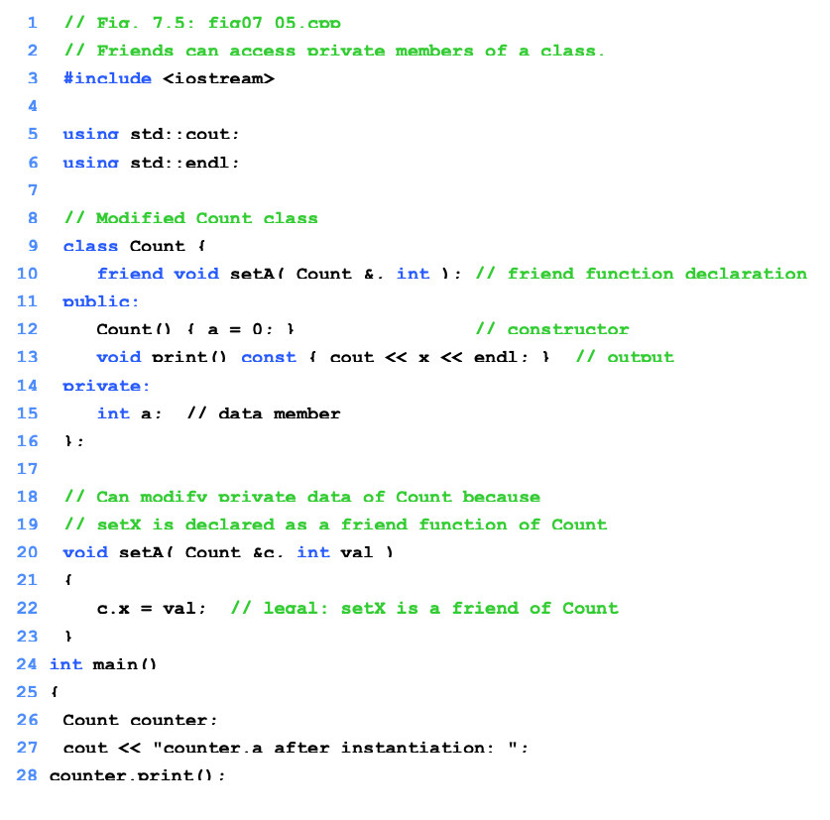
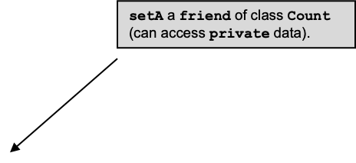
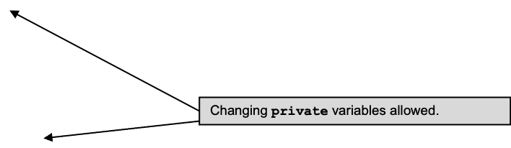
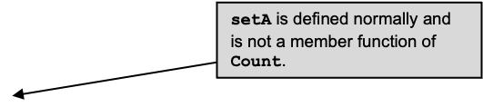

Slide 95
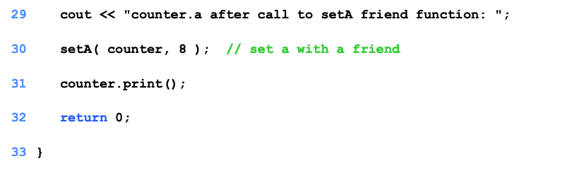
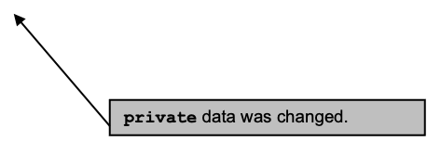
counter.a after instantiation: 0
counter.a after call to setA friend function: 8

Slide 96
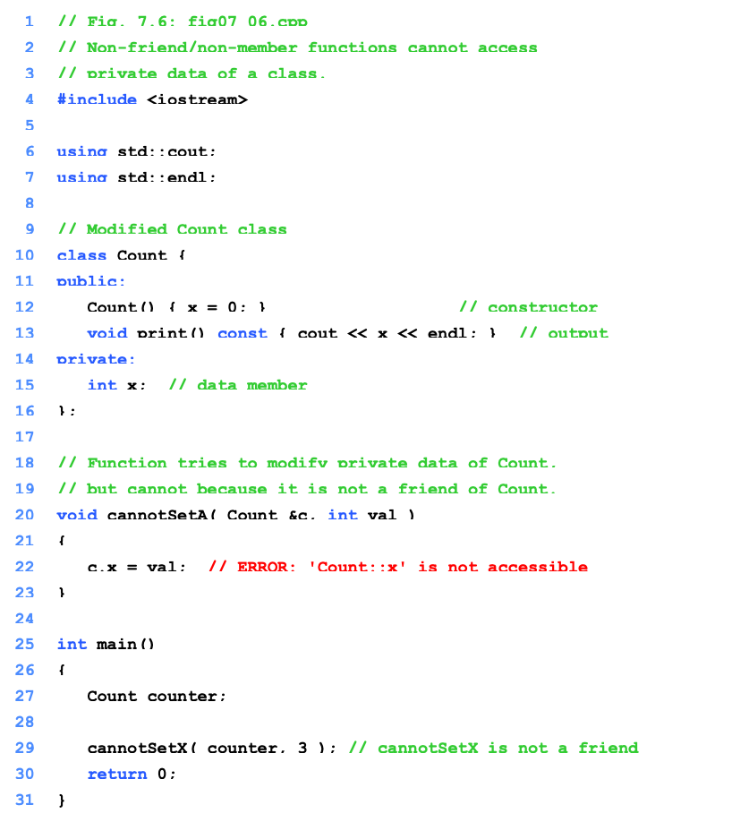
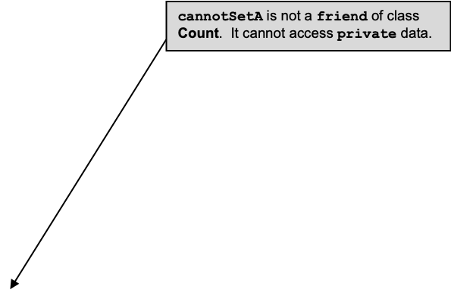
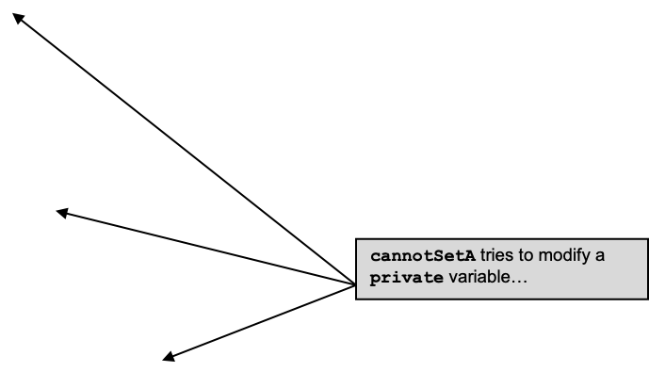

Slide 97
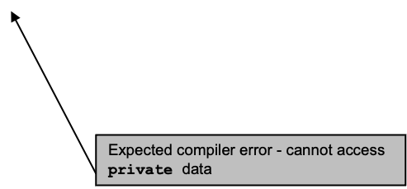
Compiling...
Fig07_06.cpp
D:\books\2000\cpphtp3\examples\Ch07\Fig07_06\Fig07_06.cpp(22) :
error C2248: 'x' : cannot access private member declared in
class 'Count'
D:\books\2000\cpphtp3\examples\Ch07\Fig07_06\
Fig07_06.cpp(15) : see declaration of 'x'
Error executing cl.exe.
test.exe - 1 error(s), 0 warning(s)

Slide 98
friend Functions and friend Classes
Friends should be used only for limited purpose
Too many functions declared as friends with private data access, lessens the value of encapsulation
Encapsulation in OOP is about hiding the complex details of an object’s internal workings and providing a simple interface to interact with it

Slide 99
#include <iostream>
using namespace std;
class BankAccount {
private:
double balance; // Private data member (encapsulated)
public:
// Constructor to initialize account balance
BankAccount(double initial_balance) : balance(initial_balance) {}
// Getter function: Access balance (read-only)
double getBalance() const {
return balance;
}

Slide 100
// Setter function: Deposit money into the account (write-only)
void deposit(double amount) {
if (amount > 0) {
balance += amount;
cout << "Deposited: $" << amount << endl;
} else {
cout << "Invalid deposit amount!" << endl;
}
}
// Setter function: Withdraw money (write-only with validation)
void withdraw(double amount) {
if (amount > 0 && amount <= balance) {
balance -= amount;
cout << "Withdrew: $" << amount << endl;
} else {
cout << "Insufficient funds or invalid withdrawal amount!" << endl;
}
}
};

Slide 101
int main() {
BankAccount account(1000); // Create an account with an initial balance of $1000
cout << "Initial Balance: $" << account.getBalance() << endl;
account.deposit(200); // Deposit $200 into the account
cout << "Balance after deposit: $" << account.getBalance() << endl;
account.withdraw(500); // Withdraw $500
cout << "Balance after withdrawal: $" << account.getBalance() << endl;
account.withdraw(800); // Attempt to withdraw more than the balance
cout << "Final Balance: $" << account.getBalance() << endl;
return 0;
}

